Slide 1
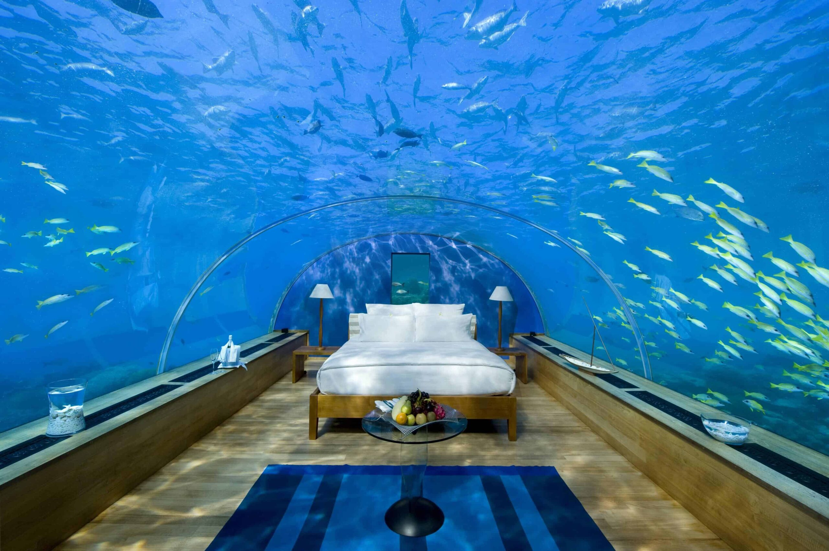
Expedia recommendation systems

Slide 2
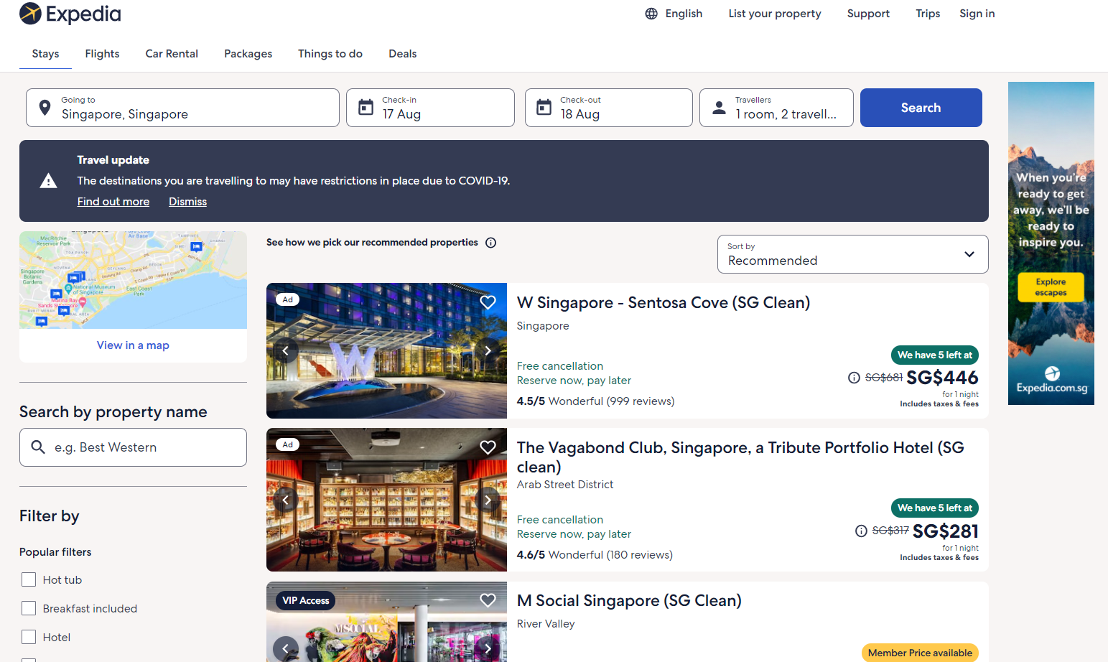

Slide 3
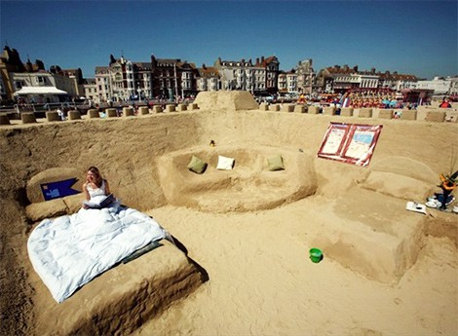


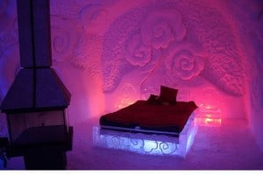

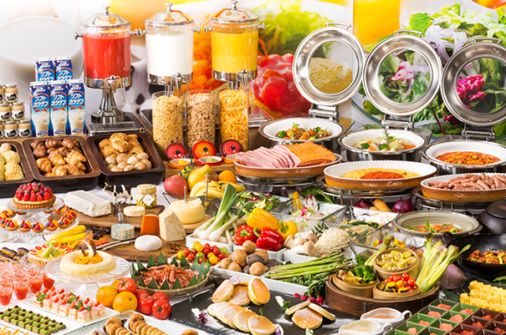

Slide 4

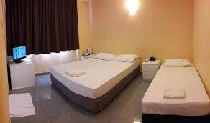

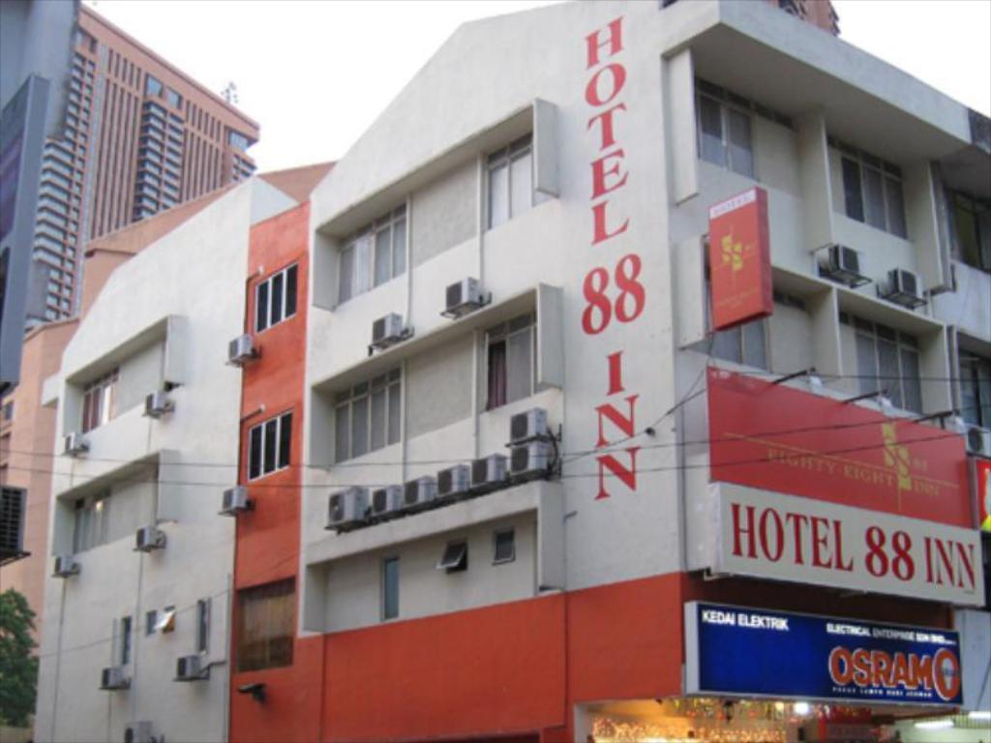

Slide 5
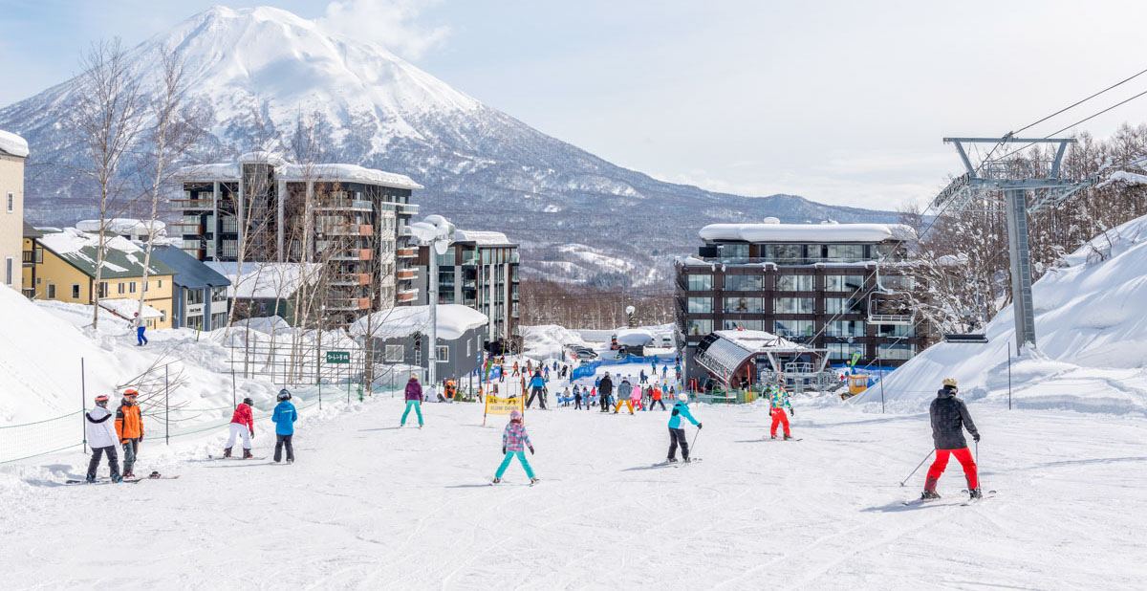
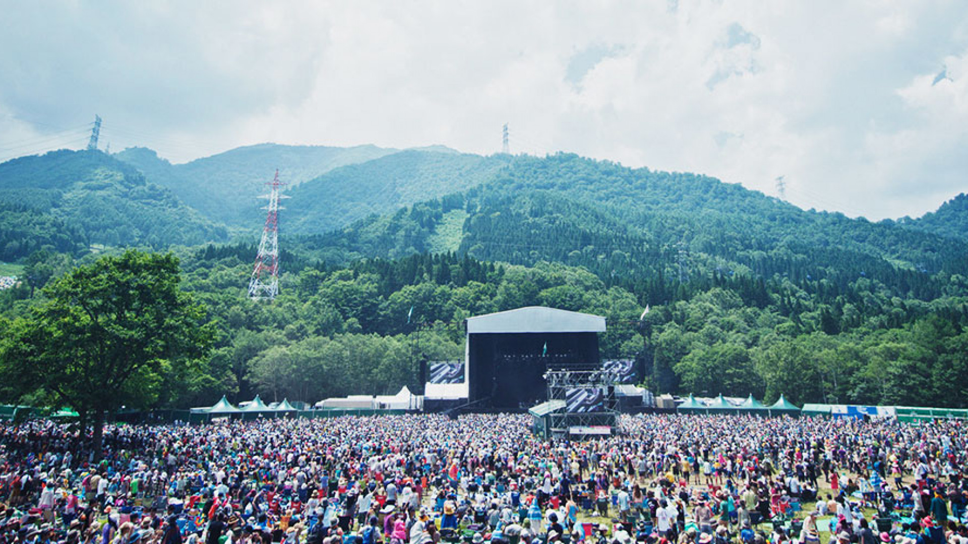
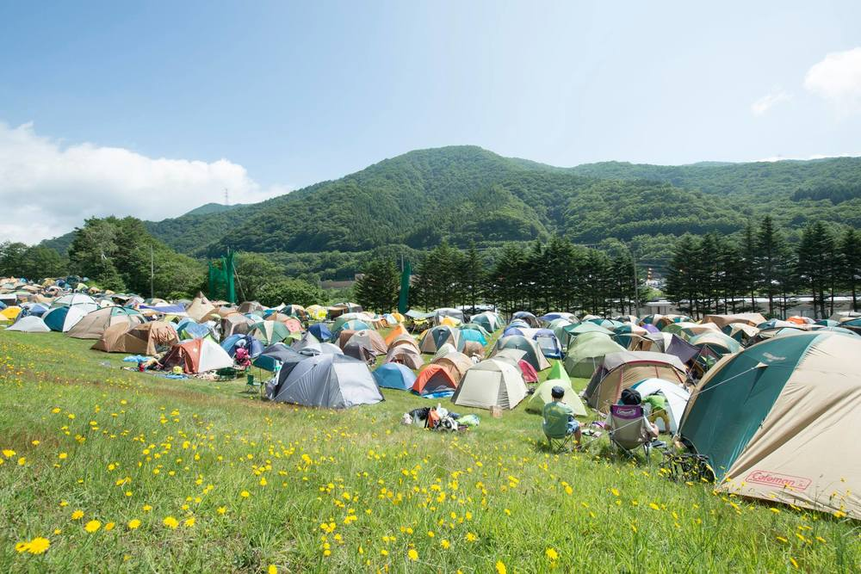


Slide 6
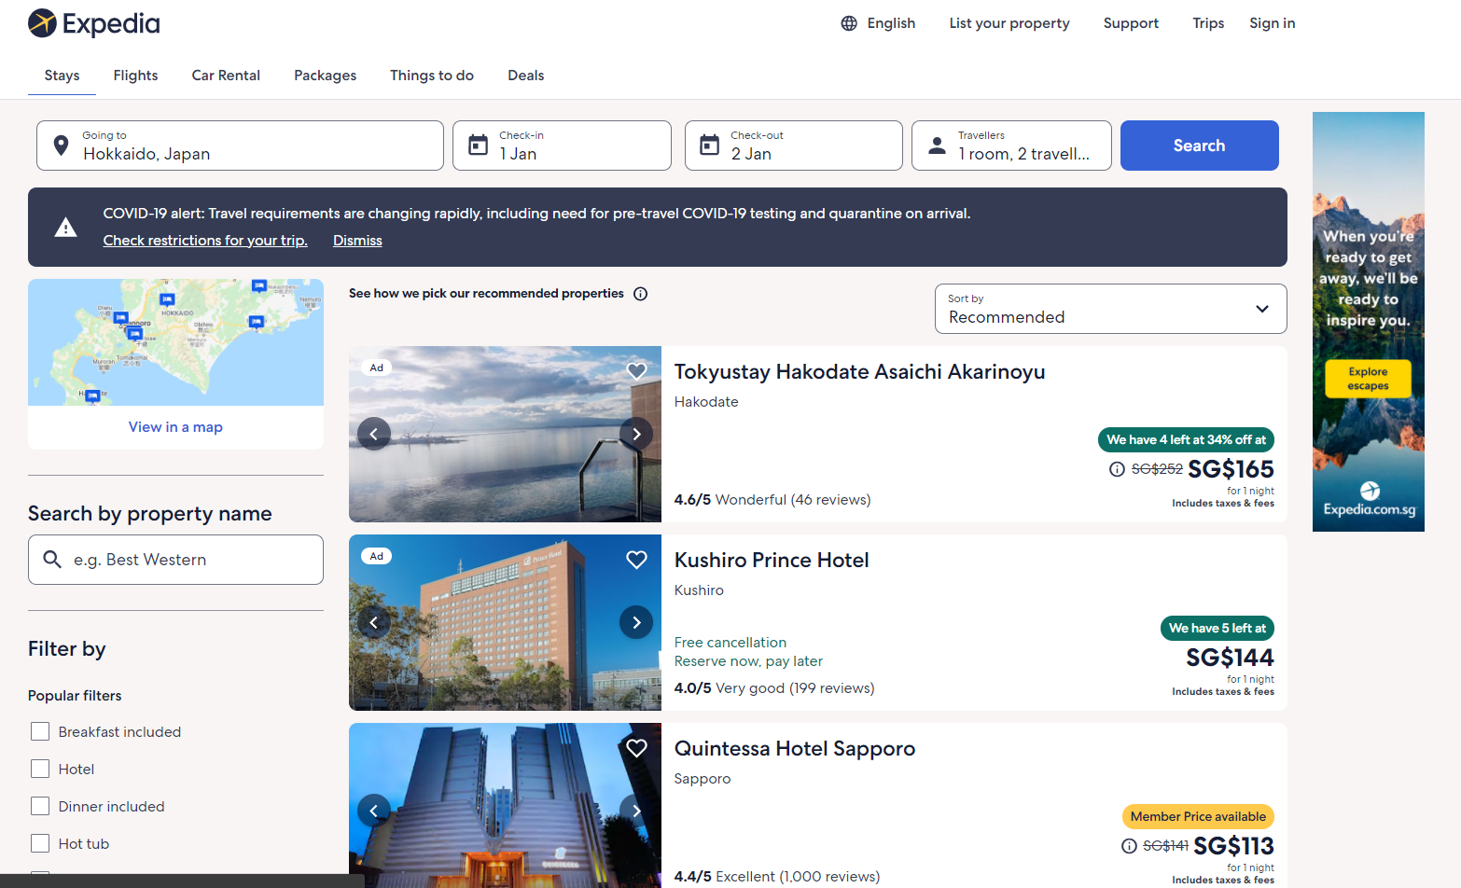
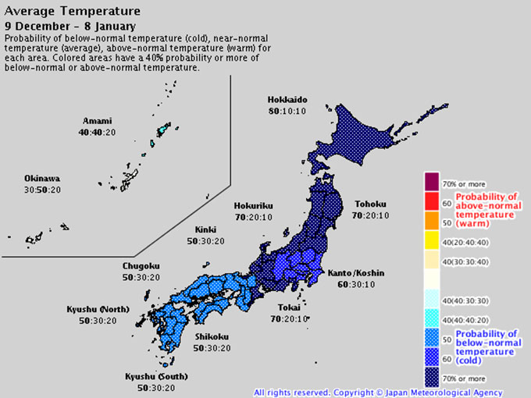

Slide 7
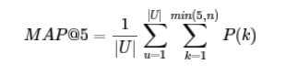
Background:
Expedia is a online travel hotel booking website. At this moment, they are using search parameters to adjust their hotel recommendations for each users. They would like to personalize their recommendations more for each user.
oBjective:
Build a model that predicts the hotel group that a user will be more likely to book from a set of 100 different hotel groups.
Metric: Mean Average Precision @ 5 (Area under the Precision and Recall curve for 5 predictions)

Slide 9
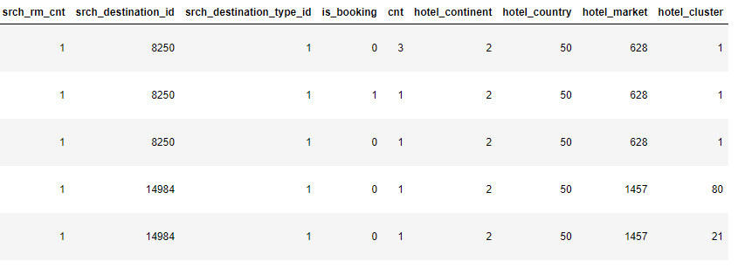
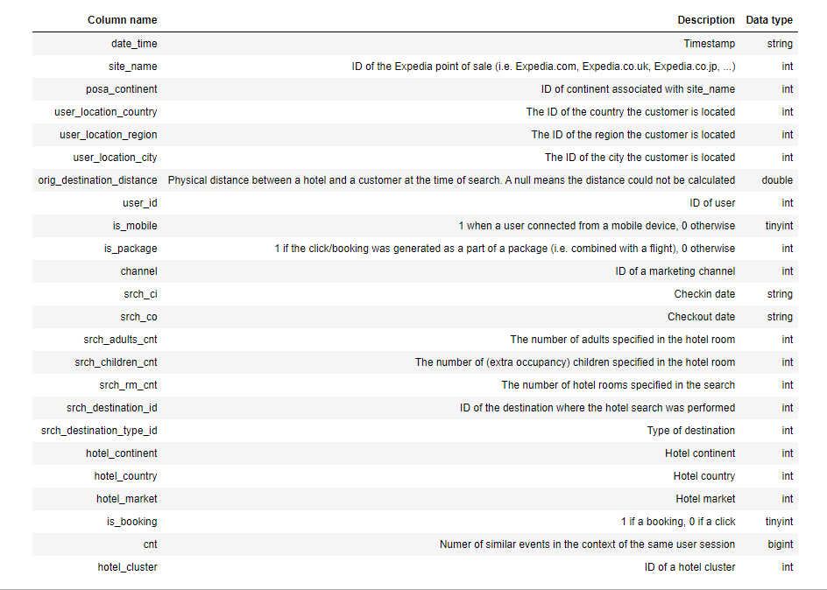
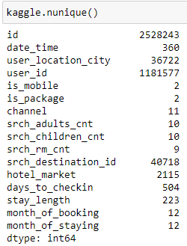
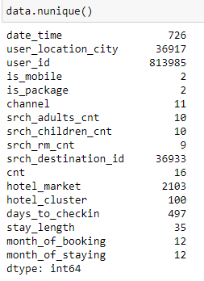
Data GIVEN
All nominal Features
High Cardinality

Slide 10
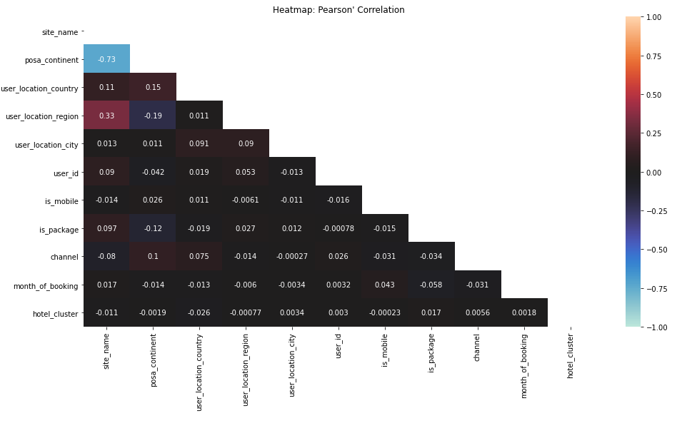

Slide 11
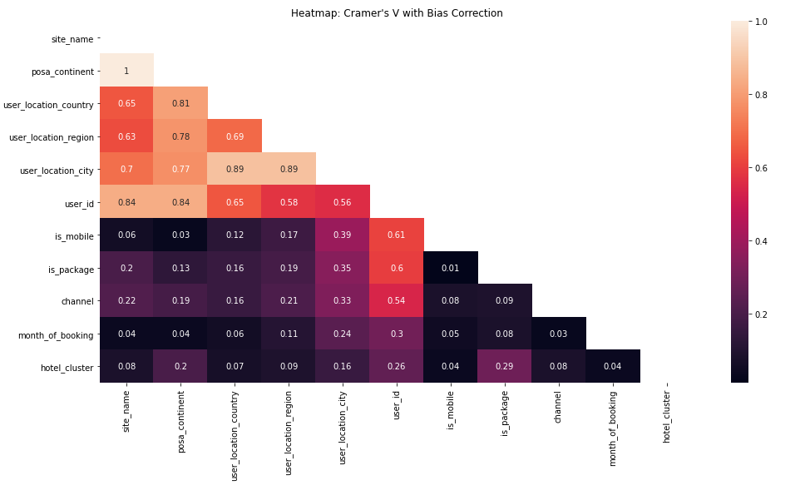

Slide 12
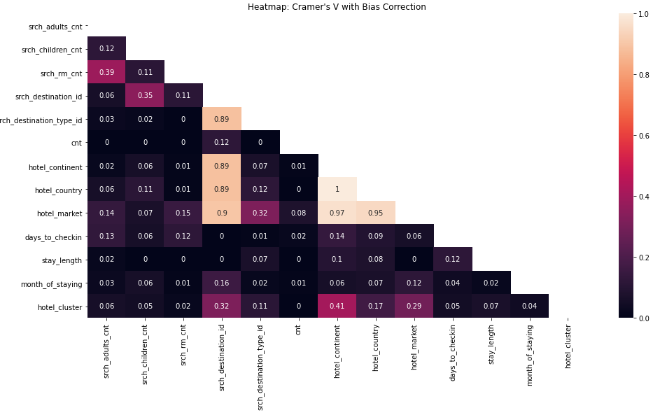

Slide 13
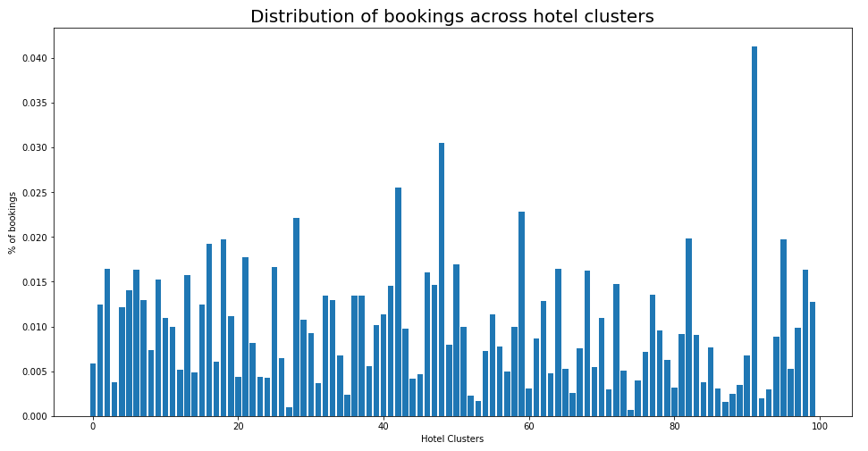

Slide 14
Models
Small Dataset (10 classes, 100,000 data) | Small Dataset (10 classes, 100,000 data)
 | Baseline | CategoricalNB (without SMOTEN) | CategoricalNB (with SMOTEN) | Random Forest Classifier (Target Encoding) | K Nearest Neighbours | Advanced TFRS
Trainset MAP@5 Score | 0.3188 | 0.7354 | 0.7224 | 0.5589 | 0.5554 | 0.9676
Holdset MAP@5 Score | 0.3188 | 0.6036 | 0.5913 | 0.4375 | 0.3213 | 0.5695
Comments |  | Problem with unseen categories. Fast Can be trained in batches. Partial fit need custom pipeline | Run out of memory. Computationally Expensive | One-Hot-Encoding Deeper Trees Needed. Computationally Expensive Target Encoding | Depends on Linearity | Tend to overfit. Fast Can be trained in batches

Slide 15
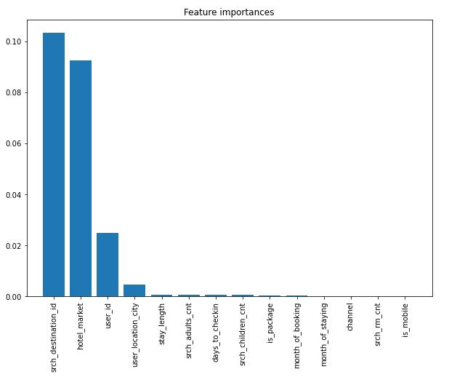
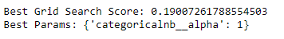
CategoricalNB
pipe = make_pipeline(
CategoricalEncoder(), OrdinalEncoder(),
CategoricalNB()
)
Custom Encoder
class CategoricalEncoder(BaseEstimator, TransformerMixin):
# Encoder to solve issue where train set might not have categories that exist in test set
# Seek to group these 'missing' categories under category 0
def __init__(self):
self.freq = {}
def fit(self, X, y = None):
for column in X.columns:
#get frequency of each category in feature
self.freq[column] = X[column].value_counts(normalize = True)
return self
def transform(self, X, y = None):
X_ = X.copy(deep = True)
for column in X.columns:
mapping = X_[column].map(self.freq[column])
#Map to category 'others' if category in testset do not appear in trainset
X_[column] = X_[column].map(lambda x: x if self.freq[column].get(x, False) else 'others')
#Map to category 'others' if category belongs to 10% of the smallest occurance
# X_[column] = X_[column].mask(mapping <= self.freq[column].quantile(q=0.1), '0')
X_[column] = X_[column].mask(mapping <= self.freq[column].quantile(q=0.1), 'others')
X_ = X_.astype(str)
return X_

Slide 16
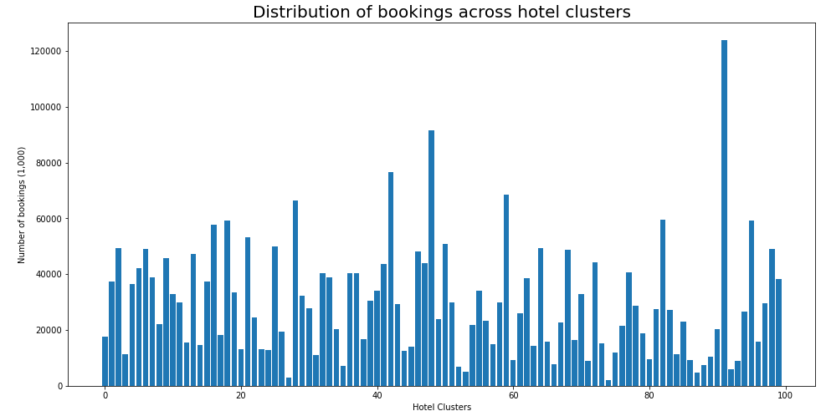
FURTHER IMPROVEMENTS
CATEGORICALNB
Undersampling and Oversampling for some of the classes within memory allowance.
Partial_fit to manage the memory usage. This will require the use of a custom pipeline.

Slide 17
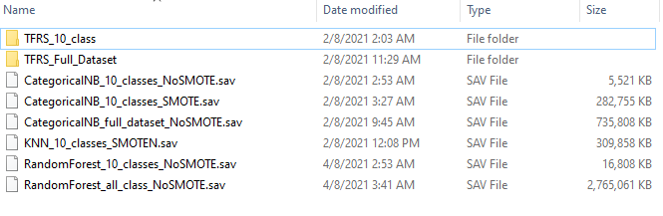
Conclusion
BEAT BASELINE BY OVER 20%
COMPARABLE TO OTHER MODELS ON KAGGLE
NOT COMPUTATIONALLY EXPENSIVE
CAN TRAIN AND IMPROVE IN BATCHES
Full Dataset | Full Dataset
 | Baseline | CategoricalNB (without SMOTE)
Trainset MAPK Score | 0.0725 | 0.4630
Holdset MAPK Score | 0.0725 | 0.3440
Kaggle Score | 0.0700 | 0.2941

Slide 18
FINAL MODELS
Full Dataset | Full Dataset
 | Baseline | CategoricalNB (without SMOTE) | Advanced TFRS
Trainset MAPK Score | 0.0725 | 0.4630 | 0.8071
Holdset MAPK Score | 0.0725 | 0.3440 | 0.3050
Kaggle Score | 0.0700 | 0.2941 | 0.2194

Slide 19
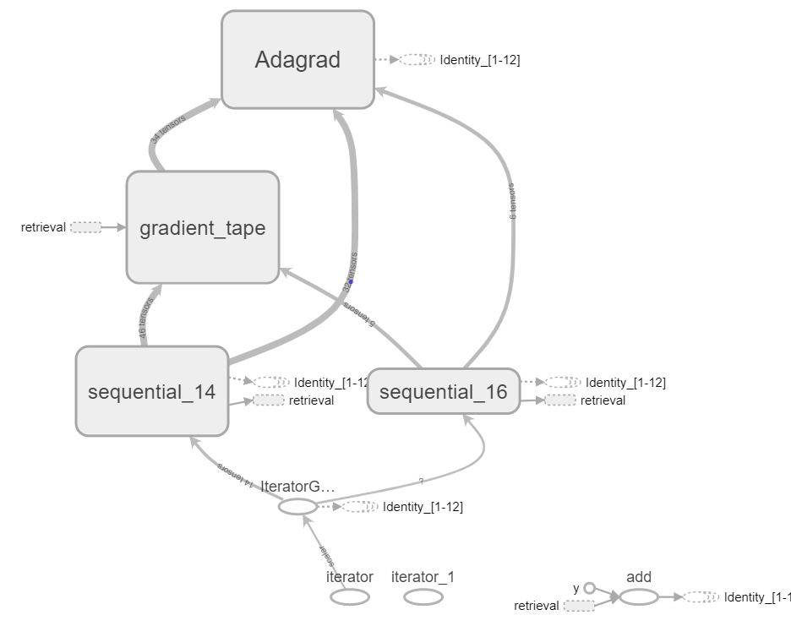
Tensorflow recommendation system
Query Model: keras.model
Hotel Market
StringLookup
Embedding
Srch Children
StringLookup
Embedding
Dense
Is Package
StringLookup
Embedding
Is Mobile
StringLookup
Embedding
Embedding
Srch Adult
Embedding
User ID
StringLookup
StringLookup
Model graph from tensorboard
Destination
StringLookup
Embedding
Retrieval Model
Tfrs.Model
User Location
StringLookup
Embedding
User ID
StringLookup
Embedding
Dense
Candidate Model:
keras.model
Hotel Cluster
StringLookup
Embedding

Slide 20
FURTHER IMPROVEMENTS
Query Model: keras.model
Retrieval Task
Hotel Market
Srch Children
StringLookup
StringLookup
Embedding
Embedding
Is Package
StringLookup
Embedding
Dense
Is Mobile
Srch Adult
StringLookup
Embedding
User ID
StringLookup
StringLookup
Embedding
TensorFlow Recommendation System
Address overfitting
Multitask TFRS model which include a ranking task.
Destination
StringLookup
Embedding
Embedding
User Location
User ID
StringLookup
StringLookup
Embedding
Embedding
Dense
Ranking Task
Candidate Model:
keras.model
Hotel Cluster
StringLookup
Embedding

Slide 21
THANK YOU

